Slide 1

Exploratory Data Analysis on AMEO dataset (2015)
By Ragamayee Aeluri

Slide 2
About me
I am Ragamayee Aeluri, a dedicated professional with a robust academic background in Electronics and Communication Engineering. My fervent enthusiasm lies in the dynamic realm of data science.Currently, I am engaged in challenging, real-world projects at Innomatics Research Labs, where I actively apply my skills and insights to address complex business problems. This hands-on experience has honed my abilities to navigate through diverse data and derive meaningful insights
Proficient in data analysis, machine learning, and statistical modeling techniques.
Skilled in programming languages such as Python.
Strong analytical and problem-solving abilities, coupled with a keen eye for detail.
LinkedIn: www.linkedin.com/in/aeluri
Github: https://github.com/RagamayeeAeluri/Exploratory_Data_Analysis_on_AMCAT_data.git
Thank you for your time and consideration. I look forward to connecting with like-minded professionals and contributing to impactful projects in the field of data science.
Warm regards, Ragamayee Aeluri

Slide 3
Dataset Overview:
The dataset comprises approximately 40 independent variables and 4000 data points, offering a robust foundation for analysis.
Independent variables exhibit both continuous and categorical characteristics, contributing to the richness and complexity of the dataset.
This study is primarily focused on students with engineering disciplines, aiming to uncover insights into their employment outcomes.
Key dependent variables of interest include Salary, Job Titles, and Job Locations, reflecting the professional trajectories of engineering graduates.
Additionally, the dataset provides standardized scores across three critical domains: cognitive skills, technical skills, and personality traits.
Notably, demographic features are also incorporated into the dataset to enable a comprehensive analysis.

Slide 4
Objective of the Project:
The primary aim of this project is to establish a correlation between the dataset provided by Aspiring Minds within the Aspiring Mind Employment Outcome 2015 (AMEO) and the corresponding salary information of its participants.
The study focuses exclusively on students with engineering backgrounds. The dataset encompasses employment outcomes for engineering graduates, with particular emphasis on dependent variables such as Salary, Job Titles, and Job Locations. Additionally, the dataset includes standardized scores representing three distinct domains: cognitive skills, technical skills, and personality traits.

Slide 5
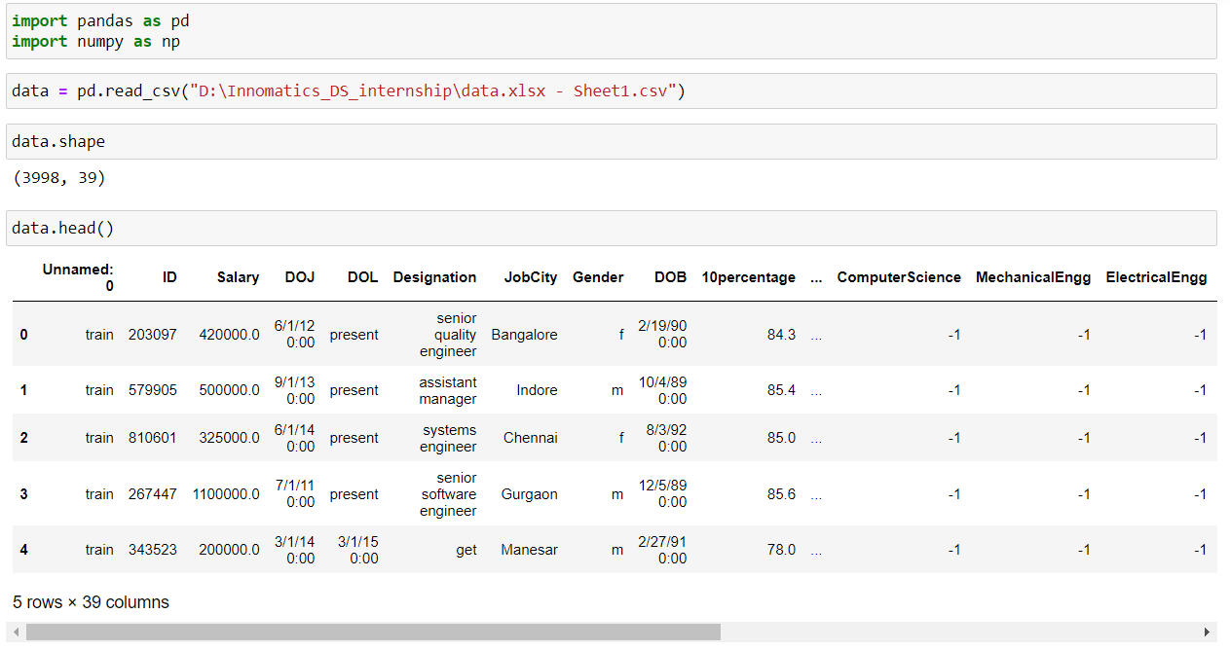
Exploratory Data Analysis
Data Cleaning Steps:

Slide 6
The data is imported into jupyter notebook and there are 39 columns 3998 rows.
But as per the data given in data description there should be 40 rows and 4000 rows.
Moving to the next part to data cleaning check in any missing values are present in the data given.

Slide 7
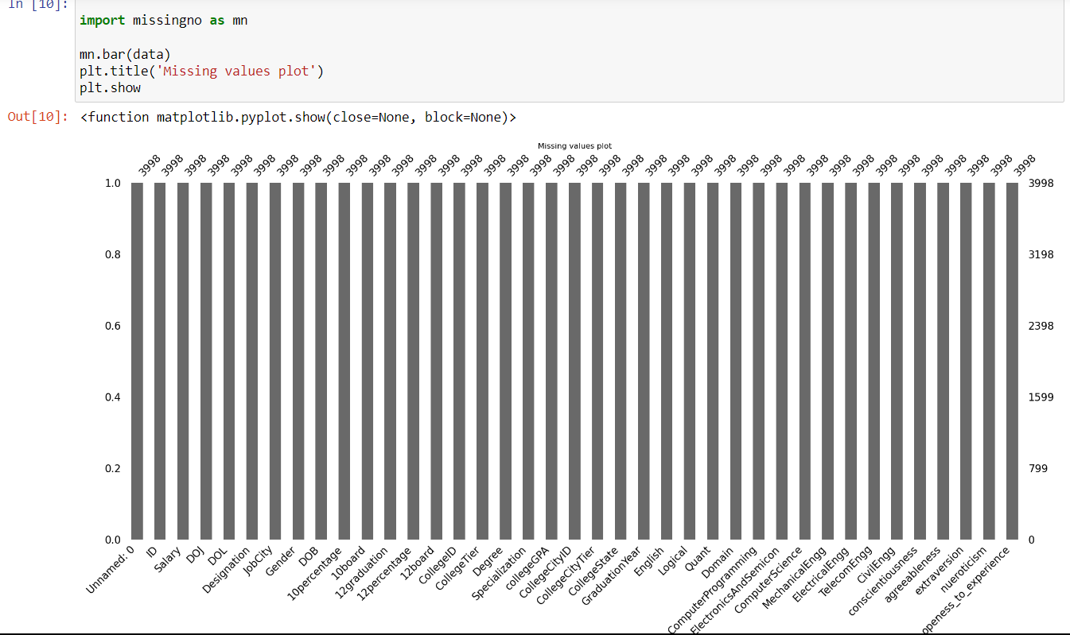
By using missingno library, we can check if there are any empty or left out cells in the data. But we don’t have any such empty cells in the dataset taken.

Slide 8
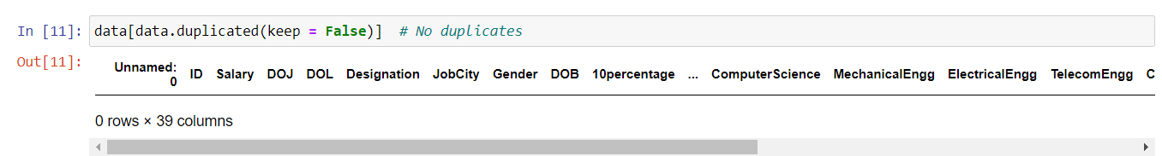
Check for duplicates in the data.
There are no duplicates in the dataset taken.

Slide 9
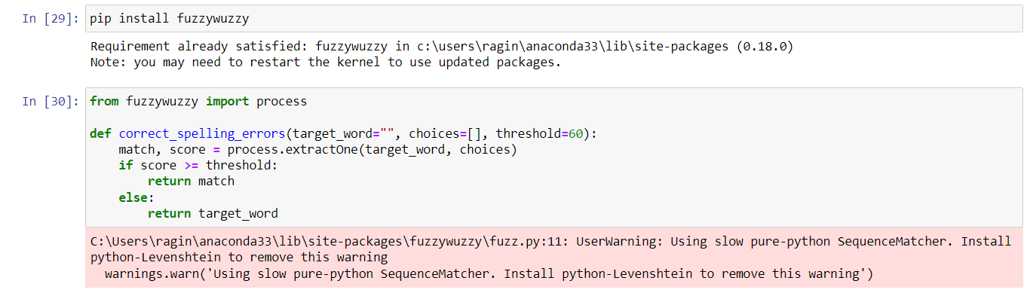
Check if there are any spelling mistakes in the data.
Using this fuzzywuzzy library check if any errors in spellings are there and rectify them.

Slide 10
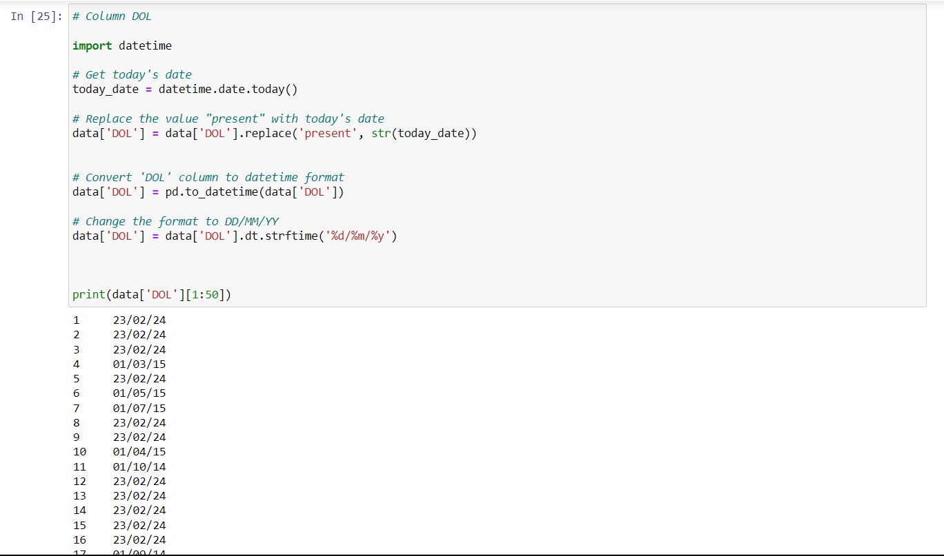
Convert the data and time format

Slide 11
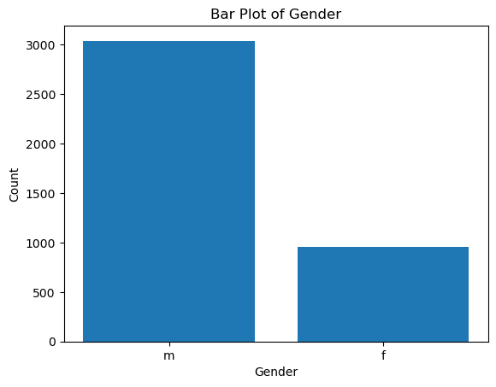
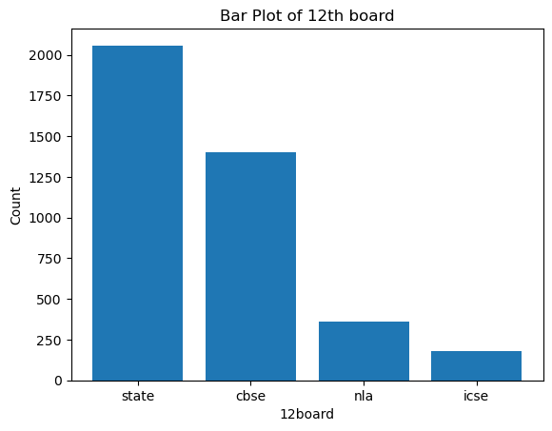
Univariate analysis on categorical data
From the above bar graphs, we can conclude that:
In the given dataset, there are round 3000 male and 1000 female participants.
From the second graph, maximum of the people(2030) studied in state board, 1400 took cbse board,300 members did not mention properly and icse students were less than 250 in count.

Slide 12
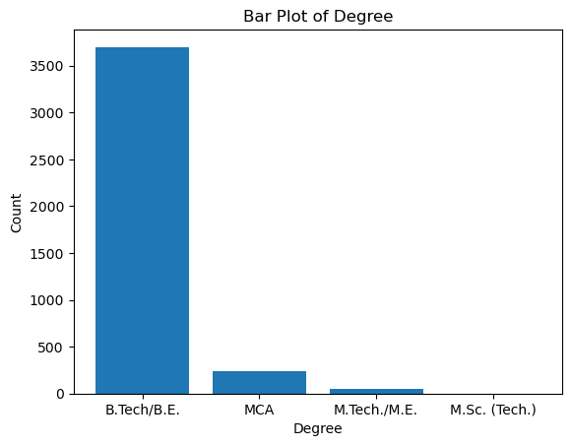
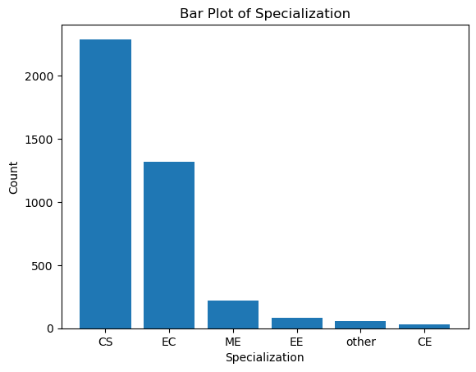
From the bar plot of degree, 93.75% of the members have done B.Tech/B.E. and very less members have done post graduation, 6.25% have done MCA and 1.25% have done M.tech/M.E.
From the bar plot of specialization, many people choose CS as the specialization and least people chose CE as a branch in their B.Tech/B.E.

Slide 13
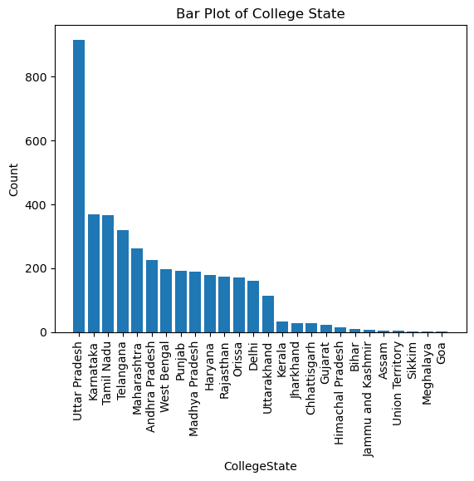
As from the plot above, we can see that 22.5% of the people have done their graduation/post graduation from Uttar Pradesh, 8.75% from Karnataka,as well from Tamil Nadu, 7.5% from Telangana, 7% from Maharashtra, 6.5% from Andhra Pradesh, 6.25% from West Bengal, 6.22% from Punjab, 6.20% from Madhya Pradesh, 6% from Haryana, 5.98% from Rajasthan and from Orissa, Delhi, Uttarakhand.

Slide 14
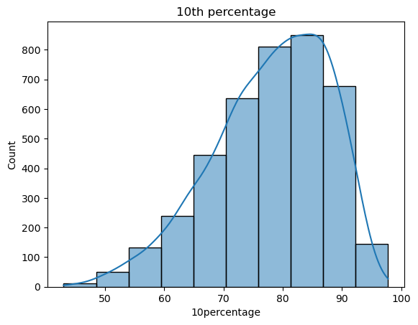
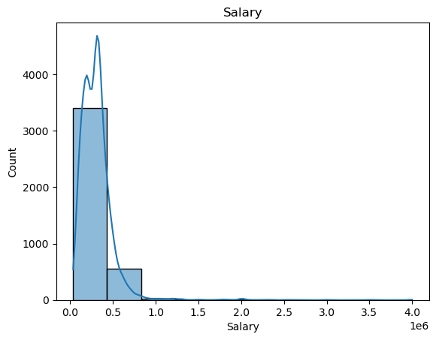
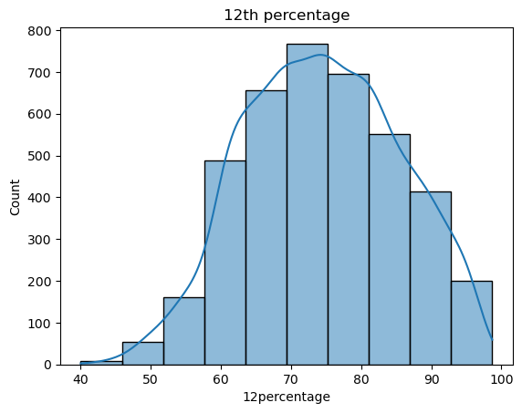
Univariate analysis on numerical data
We can see most of the salaries lie between Rs.10,000 to Rs.80,000.
Nearly there are 800 people whose scored between 80% - 90% in 10th standard and around 780 people scored between 70% -80%.

Slide 15
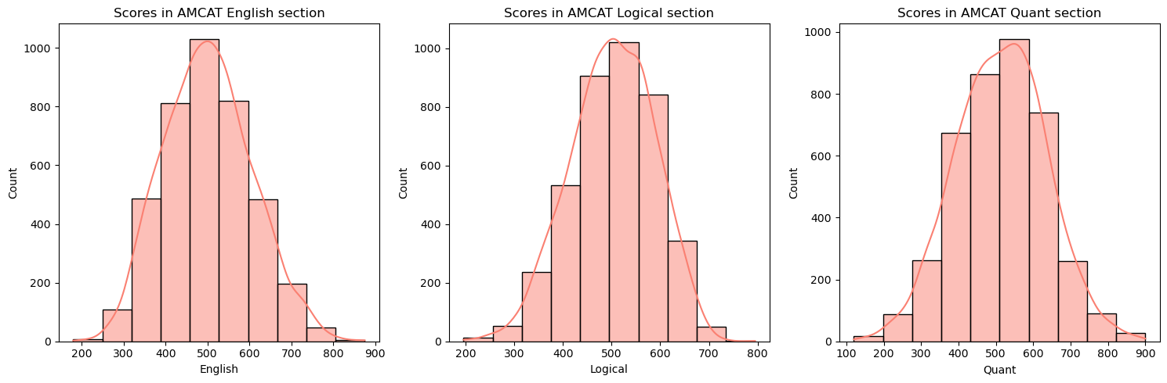
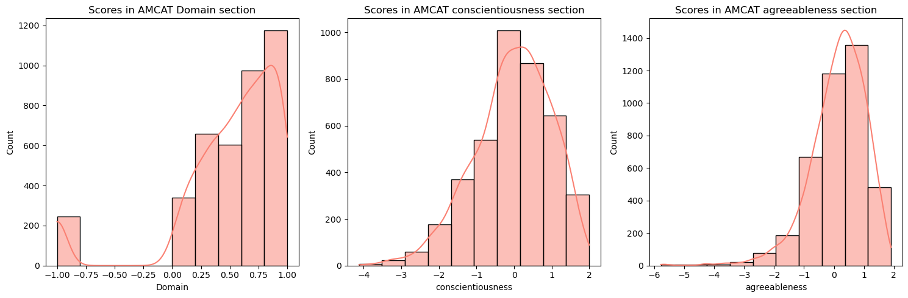
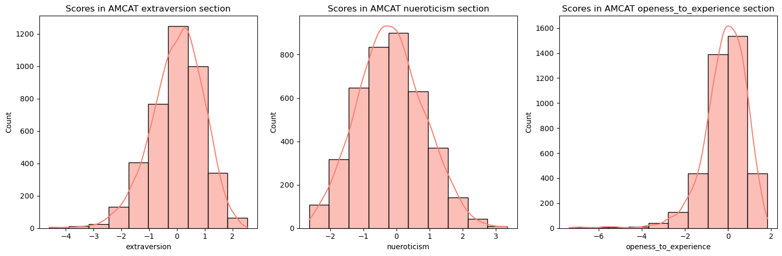

Slide 16
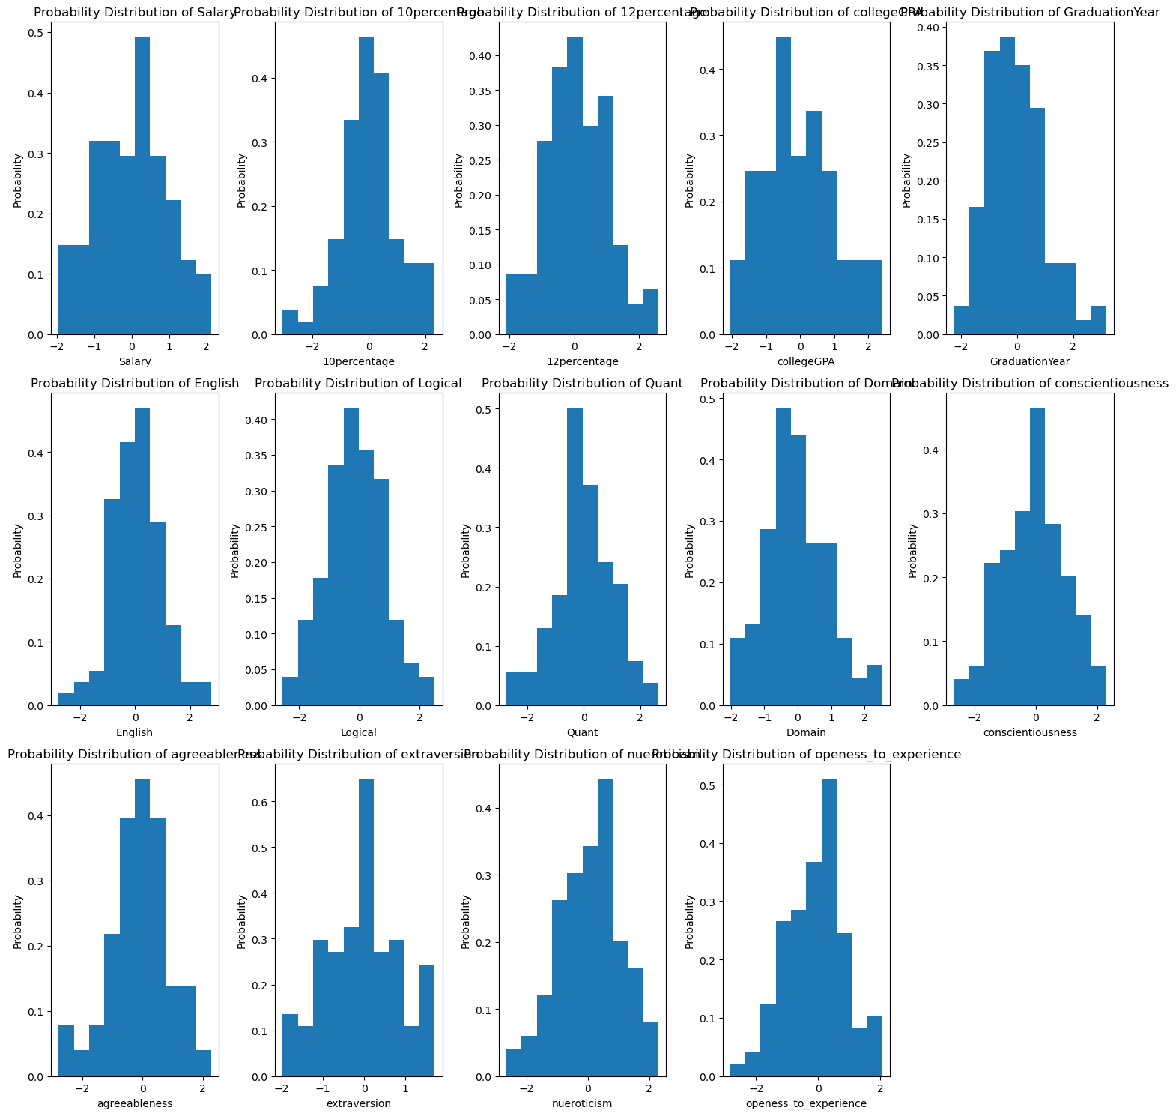
Plot the graph for Probability distribution of the numerical data

Slide 17
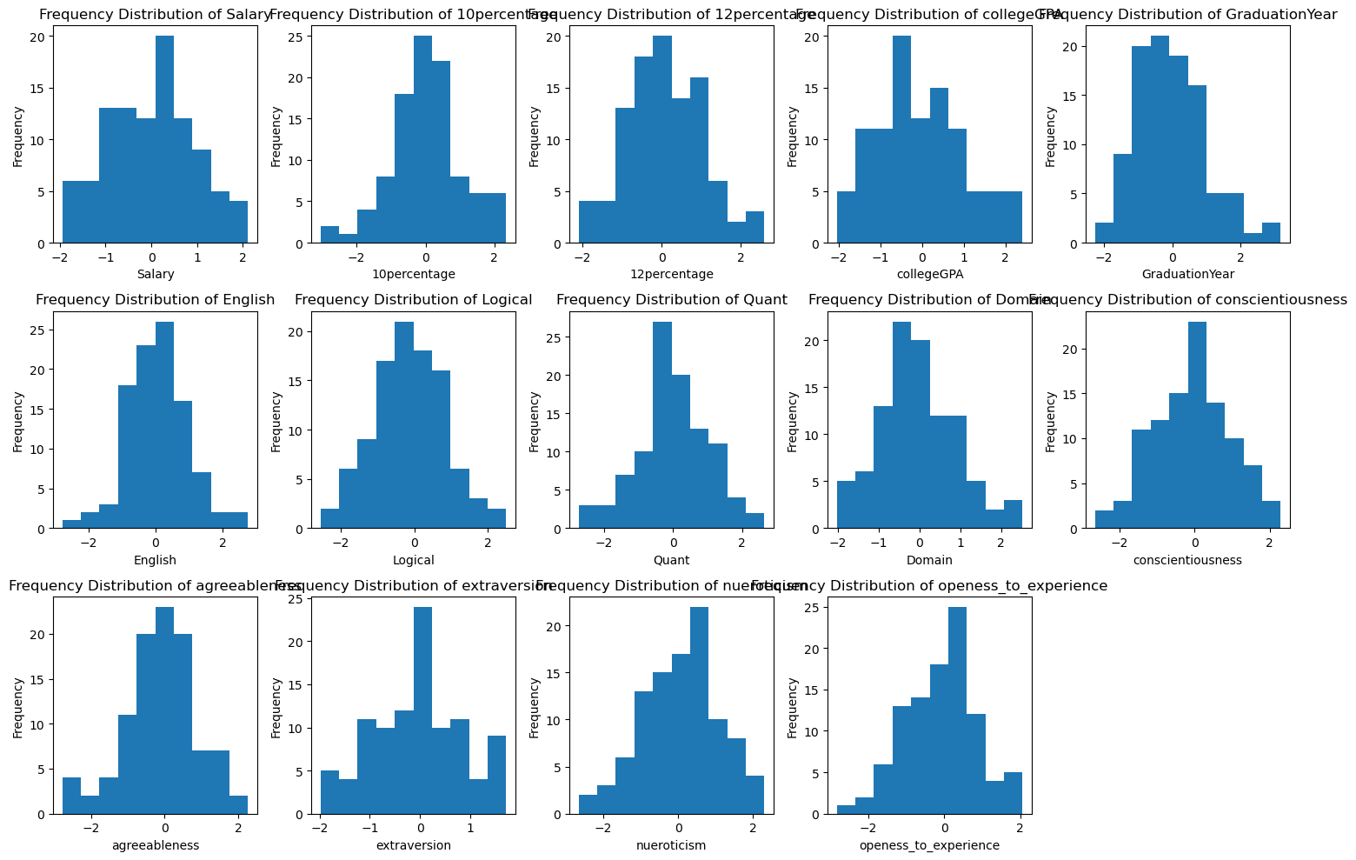
Plot the graph for Frequency Distribution of the numerical data

Slide 18
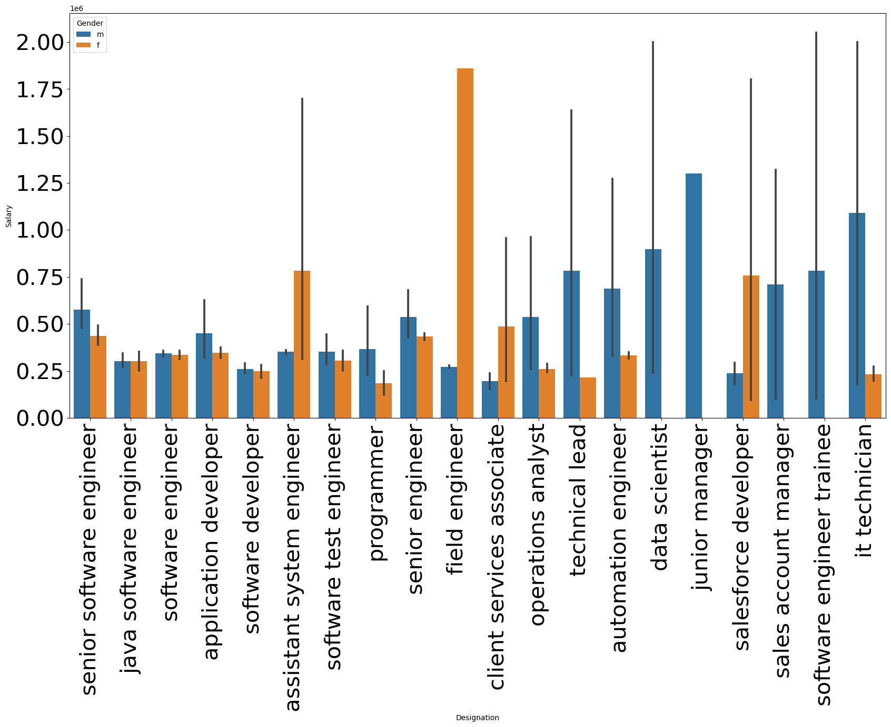
Bivariate analysis
Comparing the Gender with Salary

Slide 19
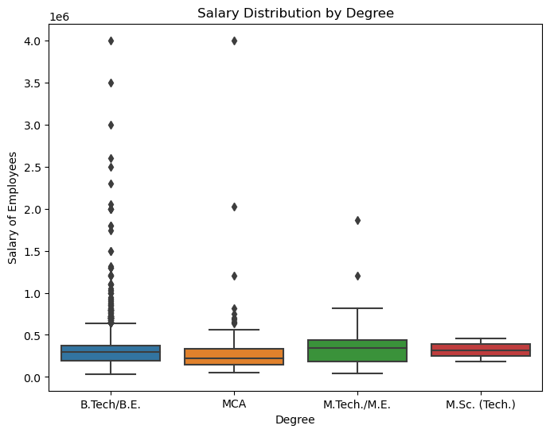
People who completed B.Tech/B.E have the highest package around 4,00,000, we can also see that salaries of people in B.Tech/B.E. have outliner salaries.
Few people who studied MCA also have very high salary.

Slide 20
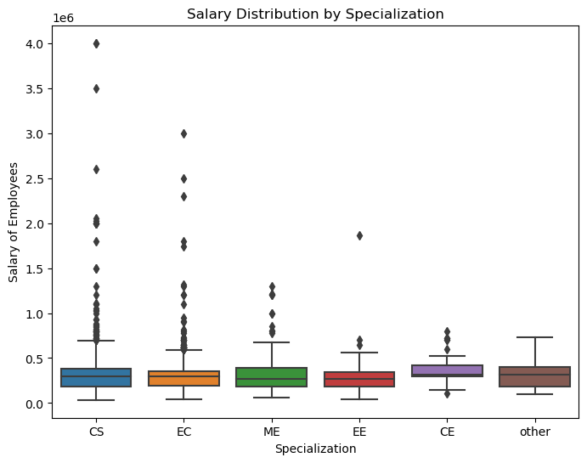
People who have done CS in their B.Tech have the highest package over all the other branches.

Slide 21
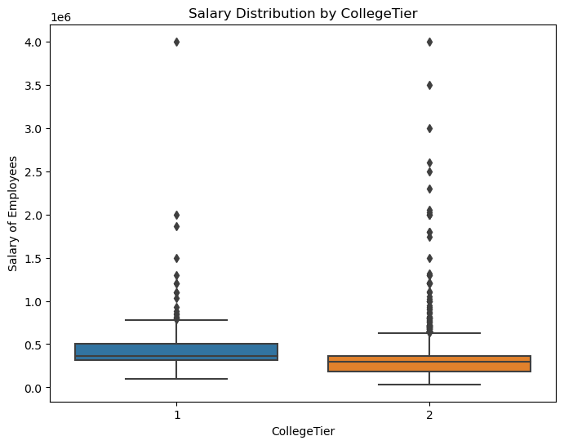
We can observe that a salary of Tier 1 college and Tier 2 college have a highest package.
But many people who have studied in Tier 2 college have high packages.

Slide 22
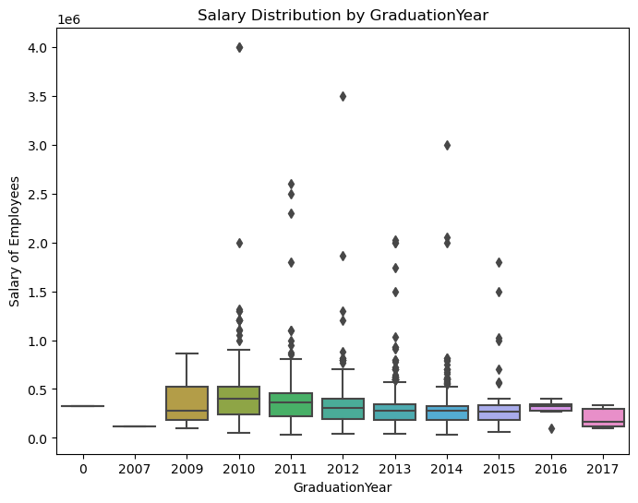
People who have done their graduation between 2010 to 2015 have the highest packages.

Slide 23
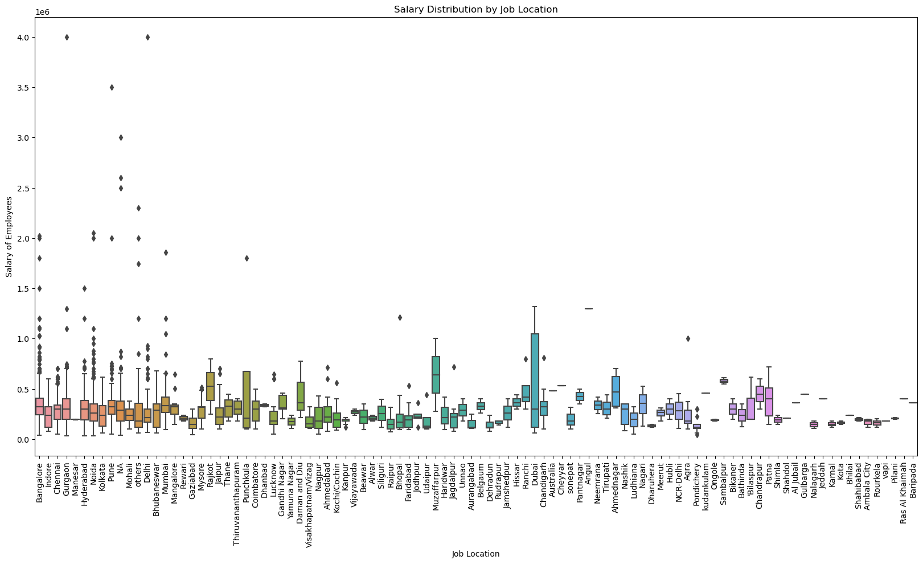
People who work in cities like Bangalore, Indore, Chennai, Gurgaon, Hyderabad, Noida, Kolkata, Delhi, Bhuvaneshwar, Mumbai have the highest packages.

Slide 24
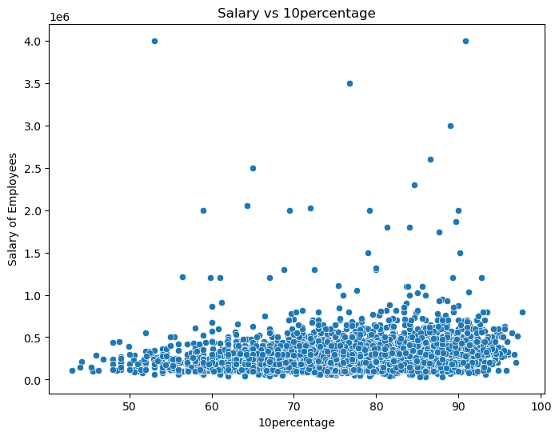

The grades in 10th and 12th does not clearly correlate with salary and define it based on these grades.

Slide 25
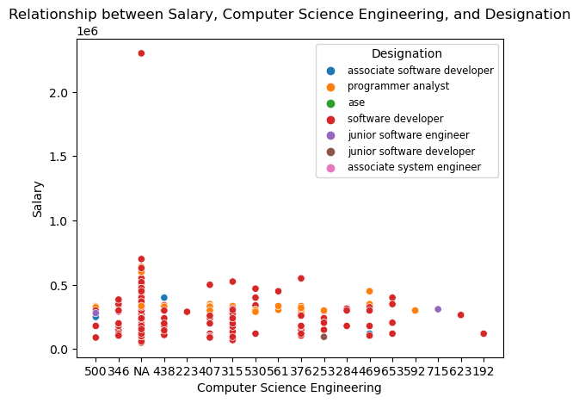
Research question:

Slide 26
Conclusion
After performing exploratory data analysis and hypothesis testing, several things are found from this project.
Gender comparison with salary: Female got the highest package as a field engineer, whereas men get highest salary as junior manager and data scientist ad per the data provided.
Effects of Academic Performance in 10th and 12th on Salary: We observed that 10th and 12th grades does not directly define the relation between salary and academic performance.
Correlation between Jobcity and salary: People who work in Bangalore have the highest average salaries compared to other cities.

Slide 27


THANK YOU

